Slide 1
Set-UID Privileged Programs

Slide 2
Reference
http://www.cis.syr.edu/~wedu/Teaching/cis643/LectureNotes_New/Set_UID.pdf
http://www.cis.syr.edu/~wedu/education/setuid.html

Slide 3
Objectives
What is privileged programs
Why they are needed, how they work
What security problems they have

Slide 4
What is privileged programs
One that can give users extra privileges beyond that are already assigned to them.
For example
web server is privileged program
because it allows remote users to access the server-side resources;
a Set-Root-UID program is a privileged program
because it allows users to gain the root privilege during the execution of the programs.

Slide 5
How Set-UID Mechanism Works

Slide 6
How Set-UID Mechanism Works
Motivation: Password dilemma
Users’ passwords are stored in /etc/shadow, which is neither readable nor writable to normal users. However, the passwd program allows users to change their passwords.
Something you can’t change, but you have to change it
Namely, when users run passwd, they can suddenly modify /etc/shadow.
Moreover users can only modify one entry in /etc/shadow, but not the other people’s entries.
How is this achieved?

Slide 7
Unix Protection systems
Protection: controlling who gets access to what
Key concepts:
Objects (the “what”)
Principles (the “who”, user or program)
Actions: (the “how”, or operations)
A protection system dictates whether an action is allowed for a principle, object
e.g., you can read or write your files, but others cannot
e.g., your can read /etc/motd but cannot write

Slide 8
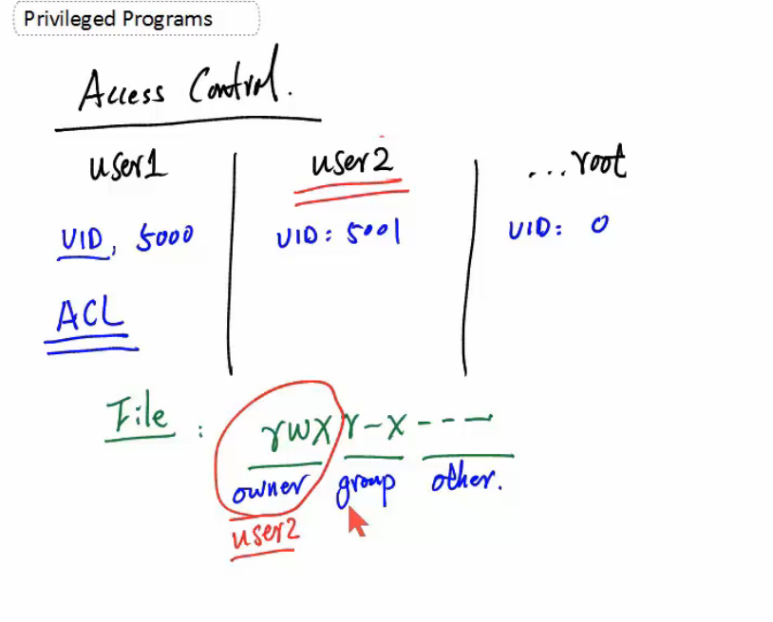

Slide 9
Model for Representing Protection
Protection can be modeled with a matrix
Two implementation strategies
Access control lists (rights stored with objects)
Capabilities (rights stored with principals)
objects
 | /etc/passwd | /home/gribble | /home/guest
root | rw | rw | rw
andrew | r | rw | r
guest |  |  | r
principals
capability
ACL

Slide 10
More on UNIX-style protection
Not a full access-control list
Can only specify owner, group, world permissions
Owner has the power to change access control
This is called discretionary access control
There is an all-power “super-user” called root
Root acts as an owner for all files
All programs run as a particular user
The user must have “execute” privilege
A program can change its user by invoking a setuid command

Slide 11
Setuid
Each process has three user IDs:
Real: the user who invoked the process
Effective: the user for access control
Saved: a previous user ID
Setuid changes the effective user
Which is the one that matters for security
Two ways to invoke
setuid() system call
setuid bit
Changes the effective user to the file owner

Slide 12
Effective uid and Real uid
For non Set-UID programs
effective uid and the real uid are the same.
For Set-UID programs
the effective uid is the owner of the program
the real uid is the user of the program

Slide 13
Effective uid and Real uid
At login time, the real user ID, effective user ID, and saved user ID of the login process are set to the login ID of the user responsible for the creation of the process
The same is true for the real, effective, and saved group IDs;
they are set to the group ID of the user responsible for the creation of the process.
When a process calls one of the exec family of functions to execute a file (program), the user and/or group identifiers associated with the process can change.
If the file executed is a set-user-ID file, the effective and saved user IDs of the process are set to the owner of the file executed.
If the file executed is a set-group-ID file, the effective and saved group IDs of the process are set to the group of the file executed.
If the file executed is not a set-user-ID or set-group-ID file, the effective user ID, saved user ID, effective group ID, and saved group ID are not changed.
Access control is based on effective user IDs and group IDs.

Slide 14
Setuid Root
Many programs run as “setuid root”
Can be invoked by anybody
But, run as root
Example:
Passwords stored in a file
Users do not have access to this file
But, they need the ability to change a password
Passwd command: ls –l to show
-rwsr-xr-x 1 root root 39104 2009-12-06 05:35 /usr/bin/passwd
setuid root is extremely dangerous
A compromised setuid program can basically do anything

Slide 15
Questions
Besides passwd, why chsh and su programs need to be Set-UID programs?
Are there Set-UID programs in Windows NT/2000? If not, how is the same problem solved in Windows?

Slide 16
Windows does not have the notion of Set-UID
A different mechanism is used for implementing privileged functionality.
A developer would write a privileged program as a service and the user sends the command line arguments to the service using Local Procedure Call.
A service can be started automatically or on-demand.
Each service has a security descriptor specifying which users are allowed to start, stop, and configure the service.
Services typically run under the Local System account.

Slide 17
How to turn on the Set-UID bit?
% chmod 4755 file ---> -rwsr-xr-x

Slide 18
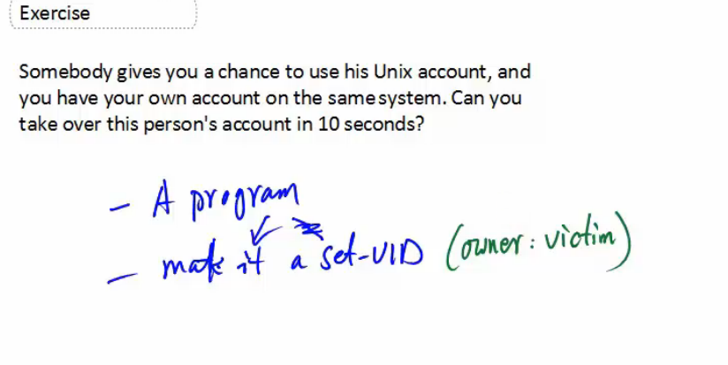

Slide 19
Malicious use of Set-UID mechanism
An attacker is given 10 seconds in your account. Can he plant a backdoor, so he can come back to your account later on?
% cp /bin/sh /tmp
% chmod 4777 /tmp/sh
By doing the above, the attacker creates a Set-UID shell program, with the you being the owner of the program.
Therefore, when the attacker later runs the shell program, it will run with your privilege.

Slide 20
Vulnerabilities of Set-UID Programs

Slide 21
A privileged program must conduct sanity check on all the inputs.
Two type of inputs
User input
Environment Variables
PATH, IFS, LD_LIBRARY_PATH , LD_PRELOAD
Input validation is actually part of the access control that a privileged program must conduct to ensure the security of the program.
A lot of security problems are caused by the mistakes in input validation.
If inputs are explicit in a program, programmers might remember to do the input validation;
if inputs are implicit, input validation may be forgotten, because programmers may not know the existence of such inputs.
Environment variables are such kind inputs.

Slide 22
UNIX process and Environment
Every UNIX process runs in a specific environment
An environment
consists of a table of environment variables, each with an assigned value.
Some programs use these environment variables internally
aka, the value of some environment variables can affect the behavior of a shell program
shell programs
Attacking
a program relies on these variables
Attackers change the values of some environment variables
To point a malicious program (e.g., shell program)
Victims call the program, attackers take control

Slide 23
Manipulating environment variables commands
Commands used in Lab (task1)
printenv, printenv PWD (path of working directory)
env
export: set an environment variable
unset: unset an environment variable
Example
%export foo=“test string”
%printenv foo
test string

Slide 24
Inheriting environment variables
In Unix, fork() creates a new process by duplicating the calling process.
the new process, referred to as the child, is an exact duplicate of the calling process, referred to as the parent;
however, several things are not inherited by the child (please see the manual of fork() by typing the following command: man fork).
Parent’s environment variables are inherited by the child process (task 2)
Command needed for the lab (task 2)
gcc –o envtest envtest.c
diff file1 and file2 //any difference between two files

Slide 25
Environment variables are affected when a new program is executed via execve().
int execve(const char *filename, char *const argv[], char *const envp[]);
envp is an array of strings
function execve() calls a system call to load a new command and execute it;
execve() runs the new program inside the calling process.
No new process is created; instead, the calling process’s text, data, bss, and stack are overwritten by that of the program loaded.

Slide 26
Example of execve()
Compare difference with following:
execve("/usr/bin/env", argv, environ);//environ is a globe environment variable
You can inherit the environment variables or specify your own

Slide 27
Risk of execve(const char *filename…, …, char *const envp[])
If the set-user-ID bit is set on the program file pointed to by filename,
the effective user ID of the calling process is changed to that of the owner of the program file.

Slide 28
system (const char *cmd)
execve() and system()
Both execute files (command)
Of course both are dangerous
depending on what is being executed when the process has root privileges.
system() brings some extra dangers
due to the additional shell "layer" it uses that opens room security breaches as it invokes a root shell as in the case of your question (i.e., the process has the suid bit).

Slide 29
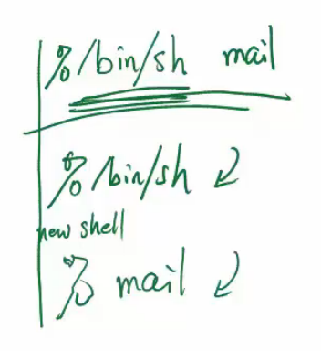
How system (const char *cmd) works
system (const char *cmd) library function
first invoke the /bin/sh program, and
then let the shell program execute cmd.
Example, system ("mail");
execve(“/bin/sh”, “-c /bin/mail”, environ);
Notes: you need to install mailutils
$ apt-get install mailutils
The attacker can change PATH to the following, and cause “mail” (in fact a shell ) in the current directory to be executed.
PATH=".:$PATH"; export PATH

Slide 30
Fix Problem Using Absolutely Path
system("/bin/mail");

Slide 31
IFS Environment Variable
IFS (Internal Field Separators)
Variable determines the characters which are to be interpreted as white spaces
Default IFS=“ \t\n";
Example of using IFS
IFS="/ \t\n"; export IFS
PATH=".:$PATH"; export PATH
system("/bin/mail"); ---> system(" bin mail");
Problem?
you call a program “bin” with a parameter “mail”
This has been fixed
by making the shells not inherit the IFS variable
https://en.wikipedia.org/wiki/Internal_field_separator

Slide 32
The PATH Environment variable and Set-UID Programs
The following program is a set-UID program and suppose to list all files.
Challenge: can you let the following program invokes your code and running with the root privilege?
Hint:
$ export PATH=/home/seed:$PATH
(Lab task 6)

Slide 33
LD_LIBRARY_PATH Environment Variable and Set-UID
In Linux, unless explicitly specified via the -static option during compilation, all Linux programs are incomplete and require further linking to the dynamic link libraries at run time.
The dynamic linker/loader ld.so/ld-linux.so
loads the shared libraries needed by a program,
prepares the program to run, and
then runs it.
Command to see what shared libraries a program depends on
% ldd /bin/ls # ls program links to libraries
Not inherited if child process is a setUID program due to security (task 5)

Slide 34
LD_LIBRARY_PATH
is an environment variable used by
the dynamic linker/loader (ld.so and ld-linux.so).
It contains a list of directories
for the linker/loader to look for when it searches for shared libraries.
Multiple directories can be listed, separated with a colon (:).
This list is prepended to the existing list of compiled-in loader paths for a given executable, and any system default loader paths.
Virtually every Unix program depends on libc.so
and virtually every windows program relies on DLL’s.
Attacking
If these libraries can be replaced by malicious copies, malicious code can be invoked when functions in these libraries are invoked.
% setenv LD_LIBRARY_PATH .:$LD_LIBRARY_PATH

Slide 35
Countermeasure
Protect Set-UID programs
ignore this environment variable
Secure applications
can also be linked statically with a trusted
In Windows machines
when loading DLLs, generally, the current directory is searched for DLLs before the system directories.
If you click on a Microsoft Word document to start Office, the directory containing that document is searched first for DLLs.

Slide 36
LD_PRELOAD Environment Variable and Set-UID
Many Unix systems allow you to ”pre-load” shared libraries
by setting an environment variable LD_PRELOAD.
user specified libraries will be loaded before all others.
used to selectively override functions in other libraries.
command to preload lib
% export LD_PRELOAD=./libmylib.so.1.0.1
If libmylib.so.1.0.1 contains a function sleep, which is a standard libc function,
when a program is executed and calls sleep, the one in libmylib.so.1.0.1 will be invoked.

Slide 37
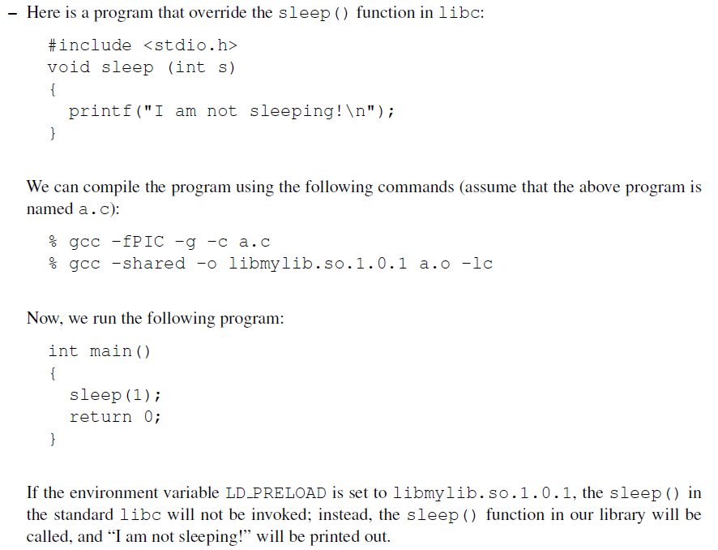
To make sure Set-UID programs are safe from the manipulation of the LD PRELOAD environment variable, the runtime linker/loader (ld.so) will ignore this environment variable if the program is a Set-UID root program, unless the real UID is also zero. (Task 8)

Slide 38
Invoking Other Programs
When a privileged program invokes other programs, attention must be paid on whether unintended programs would get invoked.
We know that environment variables are places where we should focus on our attention; there are other places that we should also focus on.

Slide 39
What are the potential problems if a Set-UID program does the following?
// The contents of User_Input are provided by users.
sprintf(command, "/bin/mail %s", User_Input);
system(command);
User Input might contain special characters for the shell: (e.g. j, &, <, >).
Remember, the system() call actually invokes shell first, and then asks the shell program to execute "/bin/mail".
If we are not careful, attackers might cause other commands to be executed by letting User Input be the following string:
xyz@example.com ; rm -f /* ; /bin/sh (Task 8)
execev() doesn’t have the problem.

